Slide 1
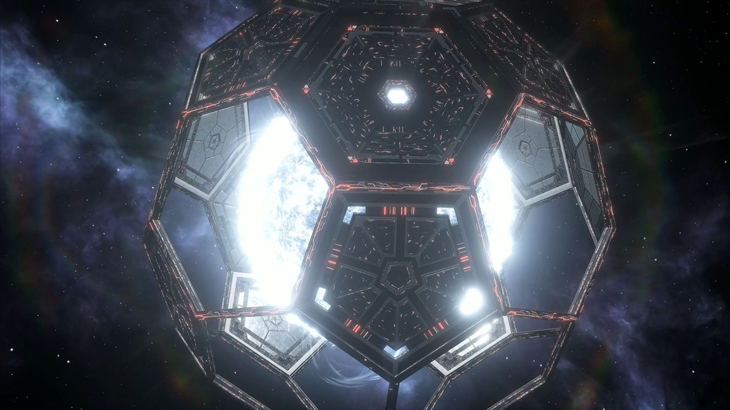
Space Based Solar Energy

Slide 2

Contents:
Introduction.
History
Working
Bla Bla Bla

Slide 3
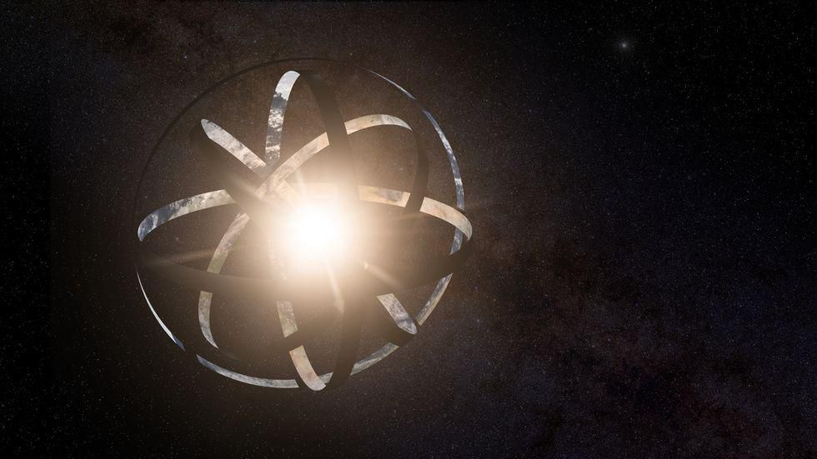
Introduction:
Space Based solar energy into.

Slide 4
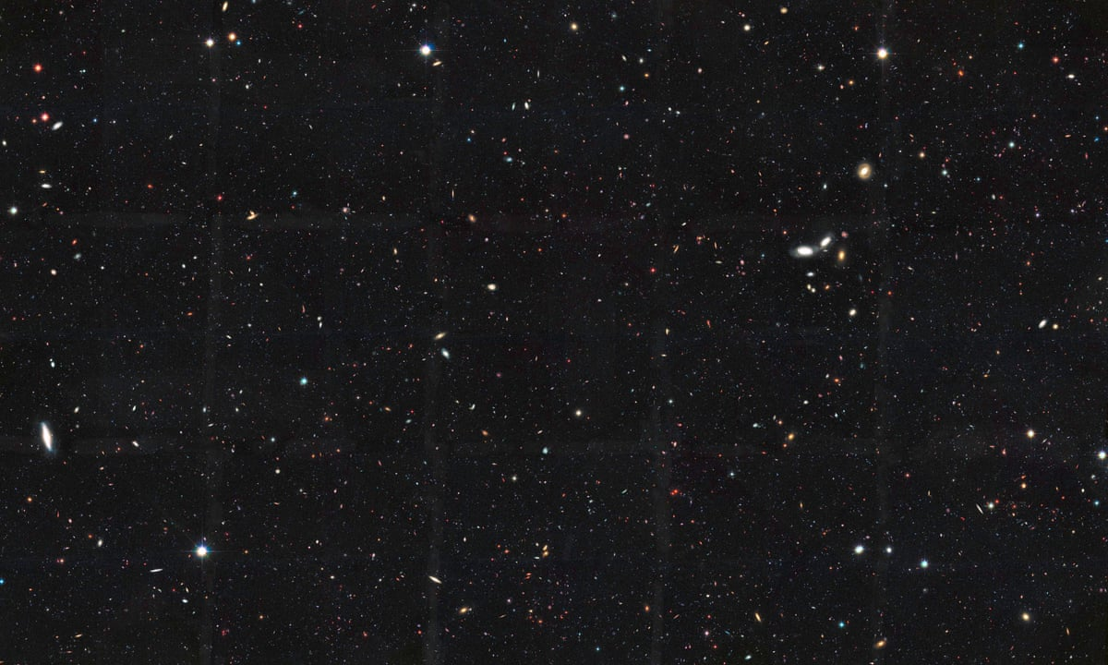
Deveploments:
Haha

Slide 5

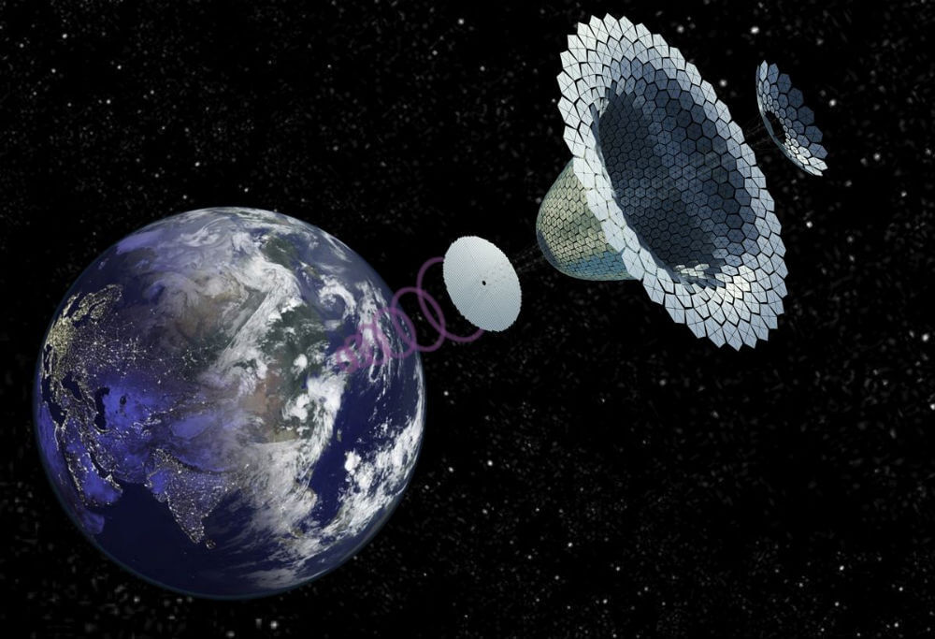
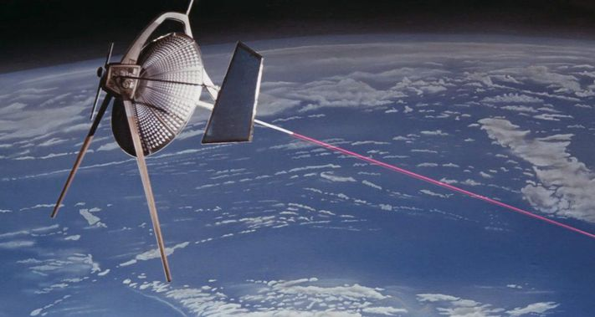
Types: There are two types:
Type 2: Laser Transmited.
Type 1: Micro-wave Transmited

Slide 6
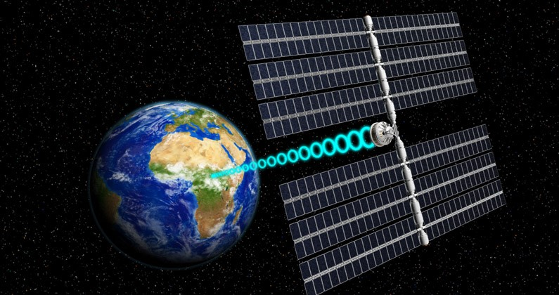
Type 1: Microwave Transmission:
Information about it.

Slide 7
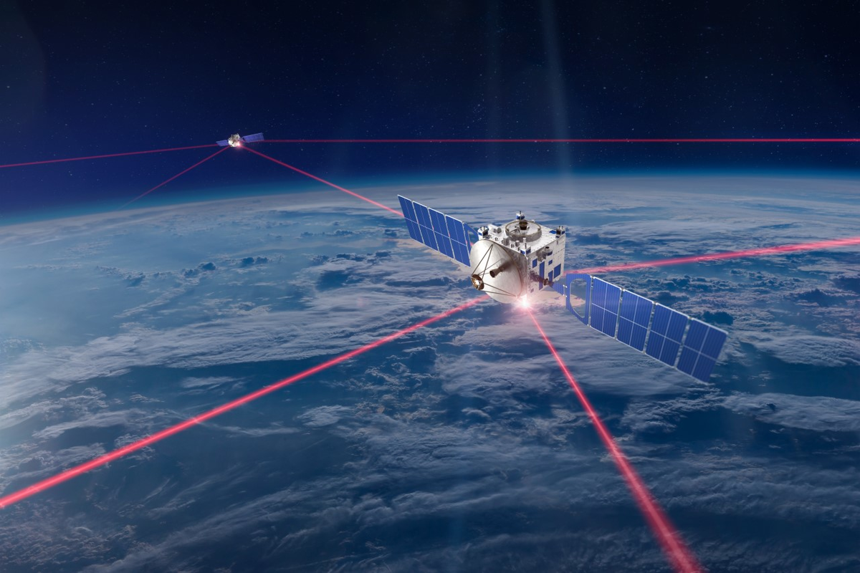
Type 2: Laser Based

Slide 8
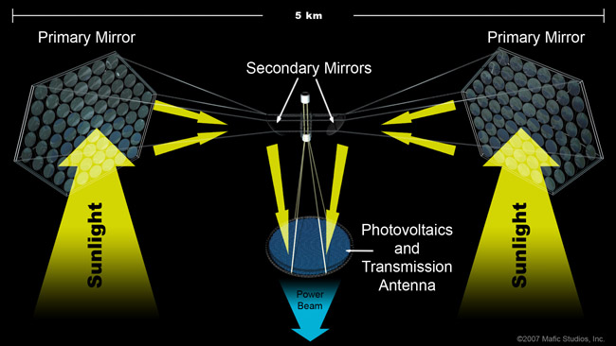
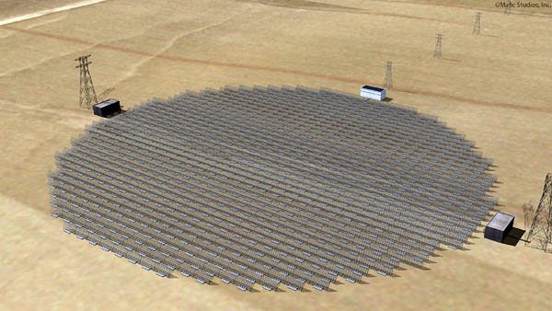
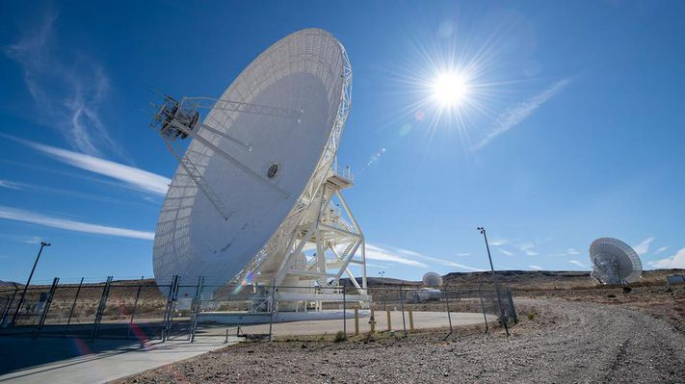

Slide 9
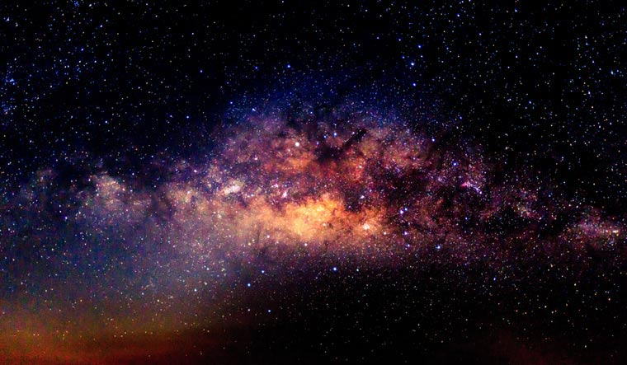
PROS: CONS:
dadads
Bla bla

Slide 10
Future

Slide 11
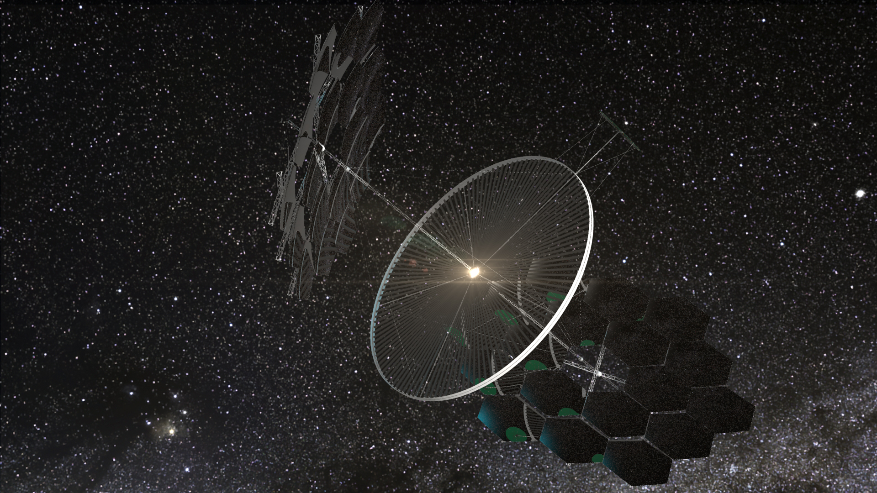
Conclusion:

Slide 12
Presented By:
References:

